Slide 1

Relational Databases and PostgreSQL
Charles Severance
www.pg4e.com

Slide 2
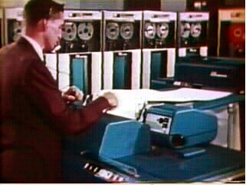

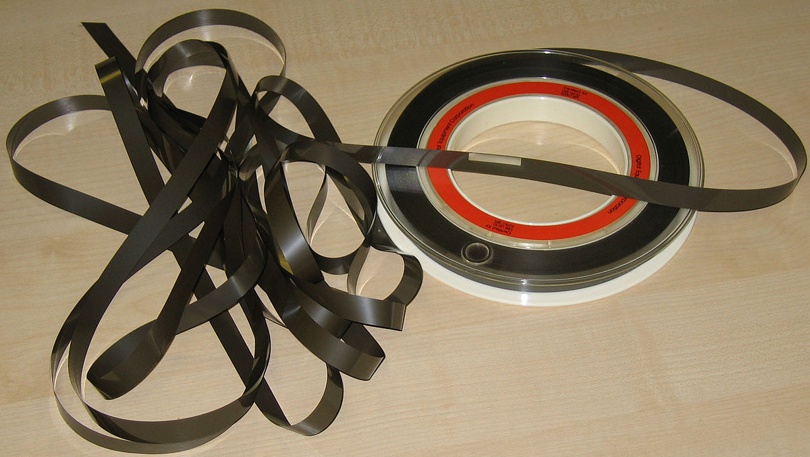
OLD
Sorted
Sequential
Master
Update
1970s
NEW
Sorted
Merge
Transactions
Sorted
https://en.wikipedia.org/wiki/IBM_729

Slide 3
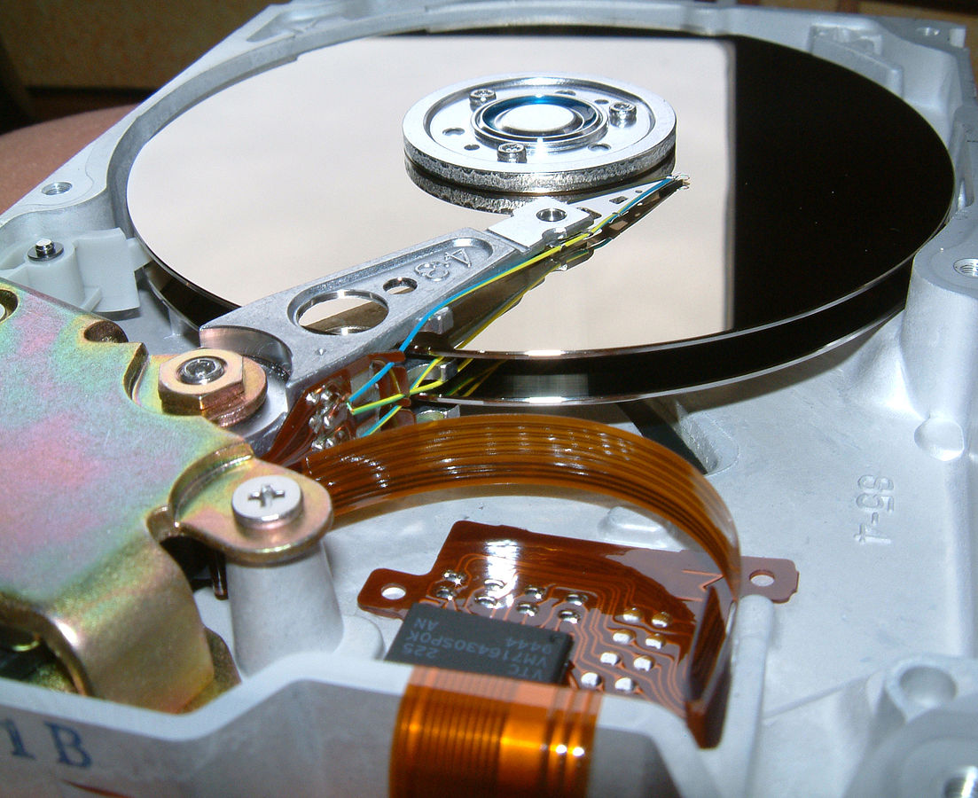
Random Access
When you can randomly access data...
How can you lay out data to be most efficient?
Sorting might not be the best idea
https://en.wikipedia.org/wiki/Hard_disk_drive_platter

Slide 4
Relational Databases
Relational databases model data by storing rows and columns in tables. The power of the relational database lies in its ability to efficiently retrieve data from those tables - in particular, where the query involves multiple tables and the relationships between those tables.
http://en.wikipedia.org/wiki/Relational_database

Slide 5
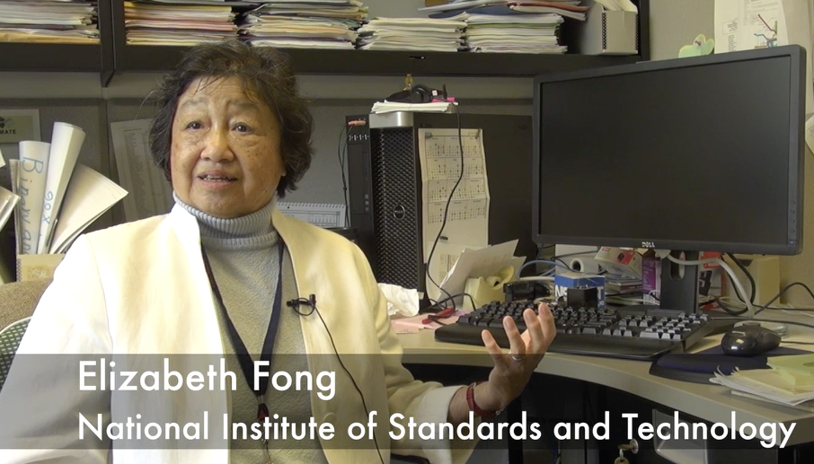
Structured Query Language
Structured Query Language (SQL) came out of a government / industry partnership
National Institute of Standards and Technology (NIST)
https://youtu.be/rLUm3vst87g

Slide 6
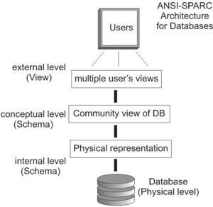
SQL
Structured Query Language is the language we use to issue commands to the database
    - Create/Insert data
    - Read/Select some data
    - Update data
    - Delete data
http://en.wikipedia.org/wiki/SQL
https://en.wikipedia.org/wiki/ANSI-SPARC_Architecture

Slide 7
Terminology
Database - contains one or more tables
Relation (or table) - contains tuples and attributes
Tuple (or row) - a set of fields which generally represent an “object” like a person or a music track
Attribute (also column or field) - one of possibly many elements of data corresponding to the object represented by the row

Slide 8
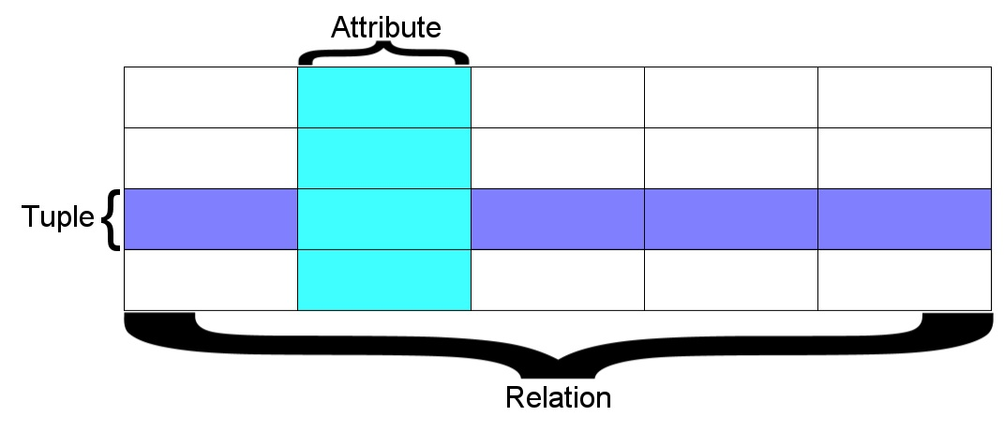
A relation is defined as a set of tuples that have the same attributes. A tuple usually represents an object and information about that object. Objects are typically physical objects or concepts. A relation is usually described as a table, which is organized into rows and columns. All the data referenced by an attribute are in the same domain and conform to the same constraints. (wikipedia)

Slide 9
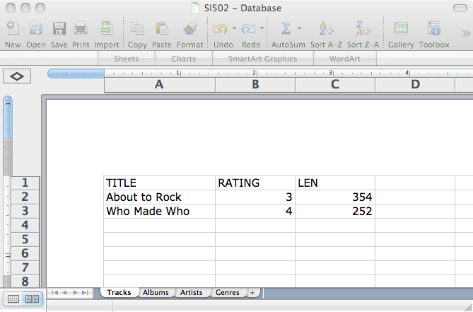
Columns / Attributes
Rows /
Tuples
Tables / Relations

Slide 10
Common Database Systems
Major Database Management Systems in wide use
  - PostgreSQL – 100% Open source, feature rich
  - Oracle - Large, commercial, enterprise-scale, very tweakable
  - MySQL - Fast and scalable - commercial open source
  - SqlServer - Very nice - from Microsoft (also Access)
Smaller projects: SQLite, HSQL, …

Slide 11
SQL Architecture

Slide 12
Using SQL
User
D.B.A.
pgAdmin
(Browser / Desktop)
Database
Server
PostgresSQL
SQL
psql
(Command
Line)
SQL

Slide 13
Starting PostgreSQL Command Line
$ psql –U postgres
Password for user postgres: <password here>
psql (9.3.5, server 11.2)
Type "help" for help.
postgres=#
Super User Prompt

Slide 14
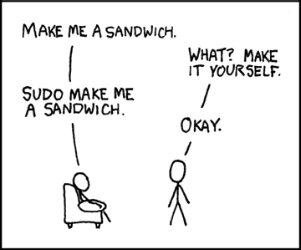
https://xkcd.com/149/

Slide 15
Your First PostgreSQL Command
postgres-# \l
List of databases
Name | Owner | Encoding | Collate | Ctype | Access privileges
-----------+----------+----------+---------+-------+-----------------------
postgres | postgres | UTF8 | C | C |
template0 | postgres | UTF8 | C | C | =c/postgres +
| | | | | postgres=CTc/postgres
template1 | postgres | UTF8 | C | C | =c/postgres +
| | | | | postgres=CTc/postgres
(3 rows)
postgres-#

Slide 16
Creating a User and Database
postgres=# CREATE USER WITH PASSWORD 'secret';
CREATE ROLE
postgres=# CREATE DATABASE people WITH OWNER '';
CREATE DATABASE
postgres=# \q
https://www.postgresql.org/docs/11/sql-createuser.html
https://www.postgresql.org/docs/11/sql-createdatabase.html

Slide 17
Connecting to a Database
$ psql people
Password for user : <password here>
psql (9.3.5, server 11.2)
people=> \dt
No relations found.
people=>
Not a Super User Prompt
https://www.postgresql.org/docs/11/app-psql.html

Slide 18
Creating a Table
people=> CREATE TABLE users(
people(> name VARCHAR(128),
people(> email VARCHAR(128)
people(> );
CREATE TABLE
people=> \dt
List of relations
Schema | Name | Type | Owner
--------+-------+-------+-------
public | users | table |
(1 row)
people=> \d+ users
Table "public.users"
Column | Type | Modifiers | Storage | Stats target | Description
--------+------------------------+-----------+----------+--------------+-------------
name | character varying(128) | | extended | |
email | character varying(128) | | extended | |
Has OIDs: no
people=>
CREATE TABLE users(
name VARCHAR(128),
email VARCHAR(128)
);

Slide 19
SQL: Insert
The INSERT statement inserts a row into a table
INSERT INTO users (name, email) VALUES ('Chuck', 'csev@umich.edu') ;
INSERT INTO users (name, email) VALUES ('Somesh', 'somesh@umich.edu') ;
INSERT INTO users (name, email) VALUES ('Caitlin', 'cait@umich.edu') ;
INSERT INTO users (name, email) VALUES ('Ted', 'ted@umich.edu') ;
INSERT INTO users (name, email) VALUES ('Sally', 'sally@umich.edu') ;

Slide 20
SQL: Delete
Deletes a row in a table based on selection criteria
DELETE FROM users WHERE email='ted@umich.edu';

Slide 21
SQL: Update
Allows the updating of a field with a WHERE clause
UPDATE users SET name='Charles' WHERE email='csev@umich.edu';

Slide 22
Retrieving Records: Select
Retrieves a group of records - you can either retrieve all the records or a subset of the records with a WHERE clause
SELECT * FROM users;
SELECT * FROM users WHERE email='csev@umich.edu';

Slide 23
Sorting with ORDER BY
You can add an ORDER BY clause to SELECT statements to get the results sorted in ascending or descending order
SELECT * FROM users ORDER BY email;

Slide 24
The LIKE Clause
We can do wildcard matching in a WHERE clause using the LIKE operator
SELECT * FROM users WHERE name LIKE '%e%';

Slide 25
The LIMIT/OFFSET Clauses
We can request the first "n" rows, or the first "n" rows after skipping some rows.
The WHERE and ORDER BY clauses happen *before* the LIMIT / OFFSET are applied.
The OFFSET starts from row 0
SELECT * FROM users ORDER BY email DESC LIMIT 2;
SELECT * FROM users ORDER BY email OFFSET 1 LIMIT 2;

Slide 26
Counting Rows with SELECT
You can request to receive the count of the rows that would be retrieved instead of the rows
SELECT COUNT(*) FROM users;
SELECT COUNT(*) FROM users WHERE email='csev@umich.edu';

Slide 27
SQL Summary
INSERT INTO users (name, email) VALUES ('Ted', 'ted@umich.edu');
DELETE FROM users WHERE email='ted@umich.edu';
UPDATE users SET name='Charles' WHERE email='csev@umich.edu';
SELECT * FROM users WHERE email='csev@umich.edu';
SELECT * FROM users ORDER BY email;
SELECT * FROM users WHERE name LIKE '%e%';
SELECT * FROM users ORDER BY email OFFSET 1 LIMIT 2;
SELECT COUNT(*) FROM users WHERE email='csev@umich.edu'

Slide 28
This is not too exciting (so far)
Tables pretty much look like big, fast programmable spreadsheets with rows, columns, and commands.
The power comes when we have more than one table and we can exploit the relationships between the tables.

Slide 29
Data Types in PostgreSQL

Slide 30
Looking at Data Types
Text fields (small and large)
Binary fields (small and large)
Numeric fields
AUTO_INCREMENT fields

Slide 31
String Fields
Understand character sets and are indexable for searching
CHAR(n) allocates the entire space (faster for small strings where length is known)
VARCHAR(n) allocates a variable amount of space depending on the data length (less space)

Slide 32
Text Fields
Have a character set - paragraphs or HTML pages
    - TEXT varying length
Generally not used with indexing or sorting - and only then limited to a prefix

Slide 33
Binary Types (rarely used)
Character = 8 - 32 bits of information depending on character set
Byte = 8 bits of information
  - BYTEA(n) up to 255 bytes
Small Images - data
Not indexed or sorted

Slide 34
Integer Numbers
Integer numbers are very efficient, take little storage, and are easy to process because CPUs can often compare them with a single instruction.
  - SMALLINT (-32768, +32768)
  - INTEGER (2 Billion)
  - BIGINT - (10**18 ish)
https://www.postgresql.org/docs/9.1/datatype-numeric.html

Slide 35
Floating Point Numbers
Floating point numbers can represent a wide range of values, but accuracy is limited.
  - REAL (32-bit) 10**38 with seven digits of accuracy
  - DOUBLE PRECISION (64-bit) 10**308 with 14 digits of accuracy
  - NUMERIC(accuracy, decimal) – Specified digits of accuracy and digits after the decimal point
https://www.postgresql.org/docs/11/datatype-numeric.html

Slide 36
Dates
TIMESTAMP - 'YYYY-MM-DD HH:MM:SS'
(4713 BC, 294276 AD)
DATE - 'YYYY-MM-DD'
TIME - 'HH:MM:SS'
Built-in PostgreSQL function NOW()
https://www.postgresql.org/docs/11/datatype-datetime.html

Slide 37
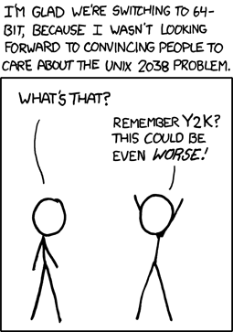
https://xkcd.com/607/

Slide 38
Database Keys and Indexes

Slide 39
AUTO_INCREMENT
Often as we make multiple tables and need to JOIN them together we need an integer primary key for each row so we can efficiently add a reference to a row in some other table as a foreign key.
DROP TABLE users;
CREATE TABLE users (
id SERIAL,
name VARCHAR(128),
email VARCHAR(128) UNIQUE,
PRIMARY KEY(id)
);

Slide 40
PostgreSQL Functions
Many operations in PostgreSQL need to use the built-in functions (like NOW() for dates).
https://www.postgresql.org/docs/11/functions.html

Slide 41
Indexes
As a table gets large (they always do), scanning all the data to find a single row becomes very costly
When drchuck@gmail.com logs into Twitter, they must find my password amongst 500 million users
There are techniques to greatly shorten the scan as long as you create data structures and maintain those structures - like shortcuts
Hashes or Trees are the most common

Slide 42
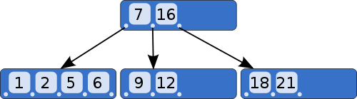
B-Trees
A B-tree is a tree data structure that keeps data sorted and allows searches, sequential access, insertions, and deletions in logarithmic amortized time. The B-tree is optimized for systems that read and write large blocks of data. It is commonly used in databases and file systems.
http://en.wikipedia.org/wiki/B-tree

Slide 43
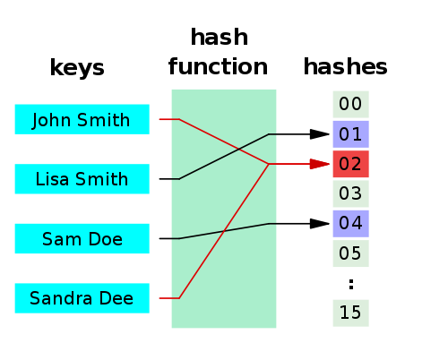
Hashes
A hash function is any algorithm or subroutine that maps large data sets to smaller data sets, called keys. For example, a single integer can serve as an index to an array (cf. associative array). The values returned by a hash function are called hash values, hash codes, hash sums, checksums, or simply hashes.
Hash functions are mostly used to accelerate table lookup or data comparison tasks such as finding items in a database...
http://en.wikipedia.org/wiki/Hash_function

Slide 44
Summary
SQL allows us to describe the shape of data to be stored and give many hints to the database engine as to how we will be accessing or using the data.
SQL is a language that provides us operations to Create, Read, Update, and Delete (CRUD) our data in a database.

Slide 45

Acknowledgements / Contributions
These slides are Copyright 2010- Charles R. Severance (www.dr-chuck.com) as part of www.pg4e.com and made available under a Creative Commons Attribution 4.0 License. Please maintain this last slide in all copies of the document to comply with the attribution requirements of the license. If you make a change, feel free to add your name and organization to the list of contributors on this page as you republish the materials.
Initial Development: Charles Severance, University of Michigan School of Information
Insert new Contributors and Translators here including names and dates
Continue new Contributors and Translators here
Notes:
Note from Chuck. Please retain and maintain this page as you remix and republish these materials. Please add any of your own improvements or contributions.

